Slide 1
Hinrich Schütze and Christina Lioma
Lecture 19: Web Search

Slide 2
Overview
Recap
Big picture
Ads
Duplicate detection

Slide 3
Outline
Recap
Big picture
Ads
Duplicate detection

Slide 4
Indexing anchor text
Anchor text is often a better description of a page’s content than the page itself.
Anchor text can be weighted more highly than the text on the page.
A Google bomb is a search with “bad” results due to maliciously manipulated anchor text.
[dangerous cult] on Google, Bing, Yahoo
4

Slide 5
PageRank
Model: a web surfer doing a random walk on the web
Formalization: Markov chain
PageRank is the long-term visit rate of the random surfer or the steady-state distribution.
Need teleportation to ensure well-defined PageRank
Power method to compute PageRank
PageRank is the principal left eigenvector of the transition probability matrix.
5

Slide 6
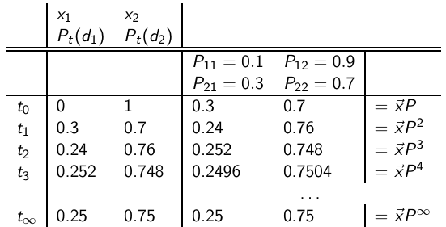
Computing PageRank: Power method
PageRank vector = π = (π1, π2) = (0.25, 0.75)
P_{t} (d₁) = P_{t−1}(d₁) ∗ P₁₁ + P_{t−1}(d₂) ∗ P₂₁
P_{t} (d₂) = P_{t−1}(d₁) ∗ P₁₂ + P_{t−1}(d₂) ∗ P₂₂
6

Slide 7
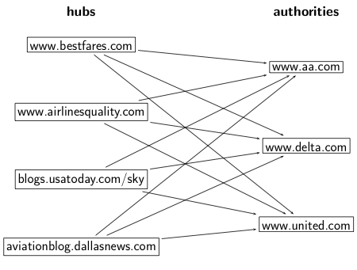
HITS: Hubs and authorities
7

Slide 8
HITS update rules
A: link matrix
h: vector of hub scores
a: vector of authority scores
HITS algorithm:
Compute h = Aa
Compute a = A^{T}h
Iterate until convergence
Output (i) list of hubs ranked according to hub score and (ii) list of authorities ranked according to authority score
8

Slide 9
Outline
Recap
Big picture
Ads
Duplicate detection

Slide 10
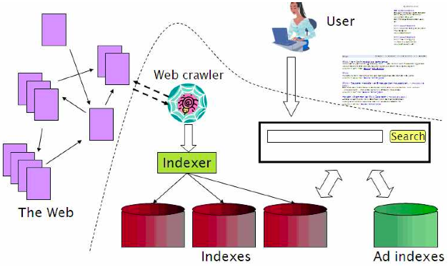
Web search overview
10

Slide 11
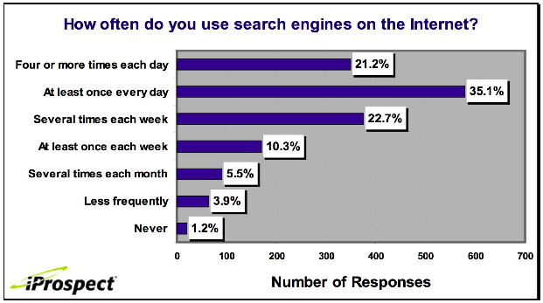
Search is the top activity on the web
11

Slide 12
Without search engines, the web wouldn’t work
Without search, content is hard to find.
→ Without search, there is no incentive to create content.
Why publish something if nobody will read it?
Why publish something if I don’t get ad revenue from it?
Somebody needs to pay for the web.
Servers, web infrastructure, content creation
A large part today is paid by search ads.
Search pays for the web.
12

Slide 13
Interest aggregation
Unique feature of the web: A small number of geographically dispersed people with similar interests can find each other.
Elementary school kids with hemophilia
People interested in translating R5R5 Scheme into relatively portable C (open source project)
Search engines are a key enabler for interest aggregation.
13

Slide 14
IR on the web vs. IR in general
On the web, search is not just a nice feature.
Search is a key enabler of the web: . . .
. . . financing, content creation, interest aggregation etc.
→ look at search ads
The web is a chaotic und uncoordinated collection. → lots of duplicates – need to detect duplicates
No control / restrictions on who can author content → lots of spam – need to detect spam
The web is very large. → need to know how big it is
14

Slide 15
Take-away today
Big picture
Ads – they pay for the web
Duplicate detection – addresses one aspect of chaotic content creation
Spam detection – addresses one aspect of lack of central access control
Probably won’t get to today
Web information retrieval
Size of the web
15

Slide 16
Outline
Recap
Big picture
Ads
Duplicate detection

Slide 17
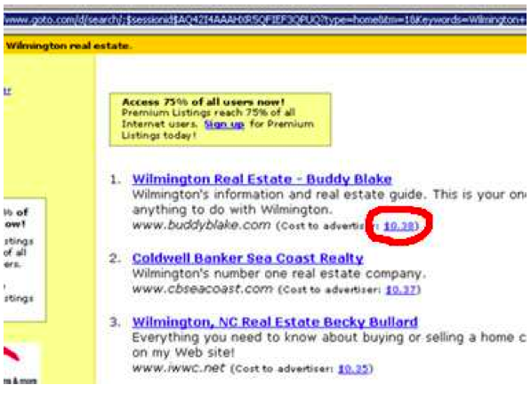
First generation of search ads: Goto (1996)
17

Slide 18
First generation of search ads: Goto (1996)
Buddy Blake bid the maximum ($0.38) for this search.
He paid $0.38 to Goto every time somebody clicked on the link.
Pages were simply ranked according to bid – revenue maximization for Goto.
No separation of ads/docs. Only one result list!
Upfront and honest. No relevance ranking, . . .
. . . but Goto did not pretend there was any.
18

Slide 19
Second generation of search ads: Google (2000/2001)
Strict separation of search results and search ads
19

Slide 20
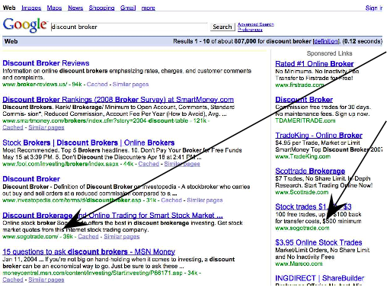
Two ranked lists: web pages (left) and ads (right)
SogoTrade appears
in search
results.
SogoTrade appears
in ads.
Do search engines
rank advertisers
higher than
non-advertisers?
All major search
engines claim no.
20

Slide 21
Do ads influence editorial content?
Similar problem at newspapers / TV channels
A newspaper is reluctant to publish harsh criticism of its major advertisers.
The line often gets blurred at newspapers / on TV.
No known case of this happening with search engines yet?
21

Slide 22
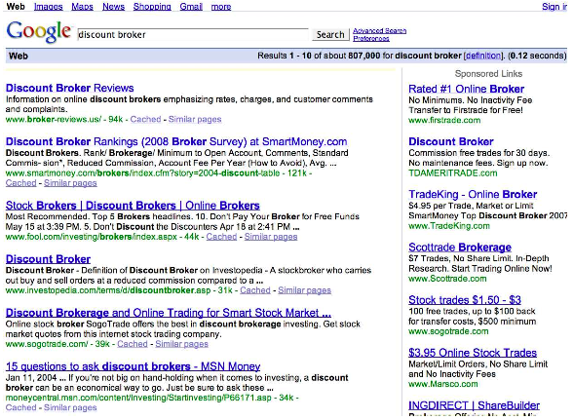
How are the ads on the right ranked?
22

Slide 23
How are ads ranked?
Advertisers bid for keywords – sale by auction.
Open system: Anybody can participate and bid on keywords.
Advertisers are only charged when somebody clicks on your ad.
How does the auction determine an ad’s rank and the price paid for the ad?
Basis is a second price auction, but with twists
For the bottom line, this is perhaps the most important research area for search engines – computational advertising.
Squeezing an additional fraction of a cent from each ad means billions of additional revenue for the search engine.
23

Slide 24
How are ads ranked?
First cut: according to bid price `a la Goto
Bad idea: open to abuse
Example: query [does my husband cheat?] → ad for divorce lawyer
We don’t want to show nonrelevant ads.
Instead: rank based on bid price and relevance
Key measure of ad relevance: clickthrough rate
clickthrough rate = CTR = clicks per impressions
Result: A nonrelevant ad will be ranked low.
Even if this decreases search engine revenue short-term
Hope: Overall acceptance of the system and overall revenue is maximized if users get useful information.
Other ranking factors: location, time of day, quality and loading speed of landing page
The main ranking factor: the query
24

Slide 25
Google AdsWords demo
25

Slide 26
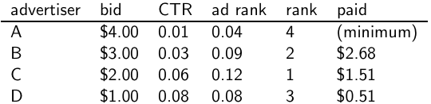
Google’s second price auction
bid: maximum bid for a click by advertiser
CTR: click-through rate: when an ad is displayed, what percentage of time do users click on it? CTR is a measure of relevance.
ad rank: bid × CTR: this trades off (i) how much money the advertiser is willing to pay against (ii) how relevant the ad is
rank: rank in auction
paid: second price auction price paid by advertiser
26

Slide 27
Google’s second price auction
Second price auction: The advertiser pays the minimum amount
necessary to maintain their position in the auction (plus 1 cent).
price₁ × CTR₁ = bid₂ × CTR₂ (this will result in rank₁=rank₂)
price₁ = bid₂ × CTR₂ / CTR₁
p₁ = bid₂ × CTR₂/CTR₁ = 3.00 × 0.03/0.06 = 1.50
p₂ = bid₃ × CTR₃/CTR₂ = 1.00 × 0.08/0.03 = 2.67
p₃ = bid₄ × CTR₄/CTR₃ = 4.00 × 0.01/0.08 = 0.50
27

Slide 28
Keywords with high bids
According to http://www.cwire.org/highest-paying-search-terms/
$69.1 mesothelioma treatment options
$65.9 personal injury lawyer michigan
$62.6 student loans consolidation
$61.4 car accident attorney los angeles
$59.4 online car insurance quotes
$59.4 arizona dui lawyer
$46.4 asbestos cancer
$40.1 home equity line of credit
$39.8 life insurance quotes
$39.2 refinancing
$38.7 equity line of credit
$38.0 lasik eye surgery new york city
$37.0 2nd mortgage
$35.9 free car insurance quote
28

Slide 29
Search ads: A win-win-win?
The search engine company gets revenue every time somebody clicks on an ad.
The user only clicks on an ad if they are interested in the ad.
Search engines punish misleading and nonrelevant ads.
As a result, users are often satisfied with what they find after clicking on an ad.
The advertiser finds new customers in a cost-effective way.
29

Slide 30
Exercise
Why is web search potentially more attractive for advertisers than TV spots, newspaper ads or radio spots?
The advertiser pays for all this. How can the advertiser be cheated?
Any way this could be bad for the user?
Any way this could be bad for the search engine?
30

Slide 31
Not a win-win-win: Keyword arbitrage
Buy a keyword on Google
Then redirect traffic to a third party that is paying much more than you are paying Google.
E.g., redirect to a page full of ads
This rarely makes sense for the user.
Ad spammers keep inventing new tricks.
The search engines need time to catch up with them.
31

Slide 32
Not a win-win-win: Violation of trademarks
Example: geico
During part of 2005: The search term “geico” on Google was bought by competitors.
Geico lost this case in the United States.
Louis Vuitton lost similar case in Europe.
See http://google.com/tm complaint.html
It’s potentially misleading to users to trigger an ad off of a trademark if the user can’t buy the product on the site.
32

Slide 33
Outline
Recap
Big picture
Ads
Duplicate detection

Slide 34
Duplicate detection
The web is full of duplicated content.
More so than many other collections
Exact duplicates
Easy to eliminate
E.g., use hash/fingerprint
Near-duplicates
Abundant on the web
Difficult to eliminate
For the user, it’s annoying to get a search result with near-identical documents.
Marginal relevance is zero: even a highly relevant document becomes nonrelevant if it appears below a (near-)duplicate.
We need to eliminate near-duplicates.
34

Slide 35
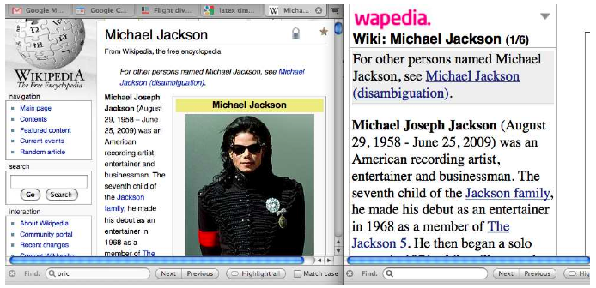
Near-duplicates: Example
35

Slide 36
Exercise
How would you eliminate near-duplicates on the web?
36

Slide 37
Detecting near-duplicates
Compute similarity with an edit-distance measure
We want “syntactic” (as opposed to semantic) similarity.
True semantic similarity (similarity in content) is too difficult to compute.
We do not consider documents near-duplicates if they have the same content, but express it with different words.
Use similarity threshold θ to make the call “is/isn’t a near-duplicate”.
E.g., two documents are near-duplicates if similarity
> θ = 80%.
37

Slide 38
Represent each document as set of shingles
A shingle is simply a word n-gram.
Shingles are used as features to measure syntactic similarity of documents.
For example, for n = 3, “a rose is a rose is a rose” would be represented as this set of shingles:
{ a-rose-is, rose-is-a, is-a-rose }
We can map shingles to 1..2^{m} (e.g., m = 64) by fingerprinting.
From now on: s_{k} refers to the shingle’s fingerprint in 1..2^{m}.
We define the similarity of two documents as the Jaccard coefficient of their shingle sets.
38

Slide 39


Recall: Jaccard coefficient
A commonly used measure of overlap of two sets
Let A and B be two sets
Jaccard coefficient:
JACCARD(A,A) = 1
JACCARD(A,B) = 0 if A ∩ B = 0
A and B don’t have to be the same size.
Always assigns a number between 0 and 1.
39

Slide 40
Jaccard coefficient: Example
Three documents:
d1: “Jack London traveled to Oakland”
d2: “Jack London traveled to the city of Oakland”
d3: “Jack traveled from Oakland to London”
Based on shingles of size 2 (2-grams or bigrams), what are the Jaccard coefficients J(d1, d2) and J(d1, d3)?
J(d1, d2) = 3/8 = 0.375
J(d1, d3) = 0
Note: very sensitive to dissimilarity
40

Slide 41
Represent each document as a sketch
The number of shingles per document is large.
To increase efficiency, we will use a sketch, a cleverly chosen subset of the shingles of a document.
The size of a sketch is, say, n = 200 . . .
. . . and is defined by a set of permutations π1 . . . π200.
Each π_{i} is a random permutation on 1..2^{m}
The sketch of d is defined as:
< min_{s∈d} π₁(s),min_{s∈d} π₂(s), . . . ,min_{s∈d} π₂₀₀(s) >
(a vector of 200 numbers).
41

Slide 42
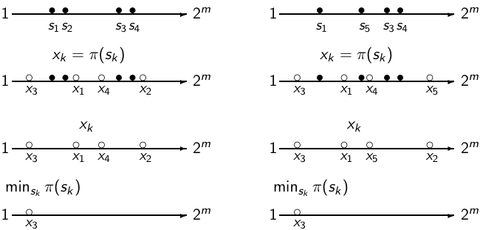
The Permutation and minimum: Example
document 1: {s_{k}} document 2: {s_{k}}
We use min_{s∈d1} π(s) = mins∈d₂ π(s) as a test for: are d₁ and d₂
near-duplicates? In this case: permutation π says: d₁ ≈ d₂
42

Slide 43
Computing Jaccard for sketches
Sketches: Each document is now a vector of n = 200 numbers.
Much easier to deal with than the very high-dimensional space of shingles
But how do we compute Jaccard?
43

Slide 44

Computing Jaccard for sketches (2)
How do we compute Jaccard?
Let U be the union of the set of shingles of d1 and d2 and I the intersection.
There are |U|! permutations on U.
For s′ ∈ I , for how many permutations π do we have
argmin_{s∈d1} π(s) = s′ = argmin_{s∈d2} π(s)?
Answer: (|U| − 1)!
There is a set of (|U| − 1)! different permutations for each s in I . ⇒ |I |(|U| − 1)! permutations make
argmin_{s∈d1} π(s) = argmin_{s∈d2} π(s) true
Thus, the proportion of permutations that make
min_{s∈d1} π(s) = min_{s∈d2} π(s) true is:
44

Slide 45
Estimating Jaccard
Thus, the proportion of successful permutations is the Jaccard coefficient.
Permutation π is successful iff min_{s∈d1} π(s) = min_{s∈d2} π(s)
Picking a permutation at random and outputting 1 (successful) or 0 (unsuccessful) is a Bernoulli trial.
Estimator of probability of success: proportion of successes in n Bernoulli trials. (n = 200)
Our sketch is based on a random selection of permutations.
Thus, to compute Jaccard, count the number k of successful permutations for < d₁, d₂ > and divide by n = 200.
k/n = k/200 estimates J(d₁, d₂).
45

Slide 46
Implementation
We use hash functions as an efficient type of permutation:
h_{i} : {1..2^{m}} → {1..2^{m}}
Scan all shingles s_{k} in union of two sets in arbitrary order
For each hash function h_{i} and documents d₁, d₂, . . .: keep slot for minimum value found so far
If h_{i} (s_{k}) is lower than minimum found so far: update slot
46

Slide 47
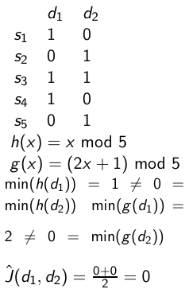
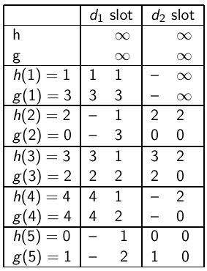
Example
final sketches
47

Slide 48
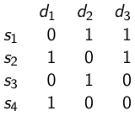


Exercise
h(x) = 5x + 5 mod 4
g(x) = (3x + 1) mod 4
48

Slide 49
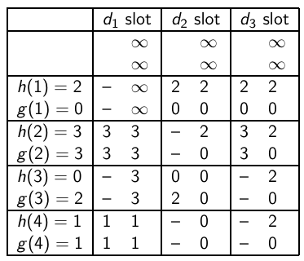
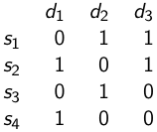
Solution (1)
h(x) = 5x + 5 mod 4
g(x) = (3x + 1) mod 4
final sketches
49

Slide 50
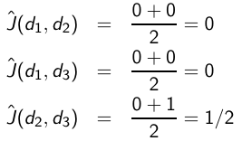
Solution (2)
50

Slide 51

Shingling: Summary
Input: N documents
Choose n-gram size for shingling, e.g., n = 5
Pick 200 random permutations, represented as hash functions
Compute N sketches: 200 × N matrix shown on previous slide, one row per permutation, one column per document
Compute pairwise similarities
Transitive closure of documents with similarity > θ
Index only one document from each equivalence class
51

Slide 52
Efficient near-duplicate detection
Now we have an extremely efficient method for estimating a Jaccard coefficient for a single pair of two documents.
But we still have to estimate O(N²) coefficients where N is the number of web pages.
Still intractable
One solution: locality sensitive hashing (LSH)
Another solution: sorting (Henzinger 2006)
52

